Slide 1

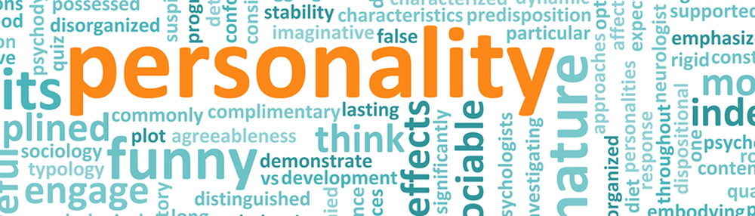

IST 736 – Text mining
Authors:
Jonathan Ortiz
Maryse khoury
Neal bates
Sandra Haskins

Slide 2

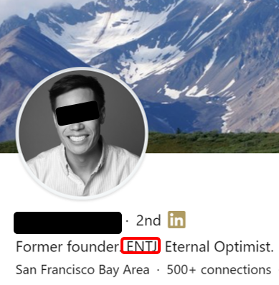


Do companies really look at personality types? Can Your Social media posts determine your personality type?

Slide 3
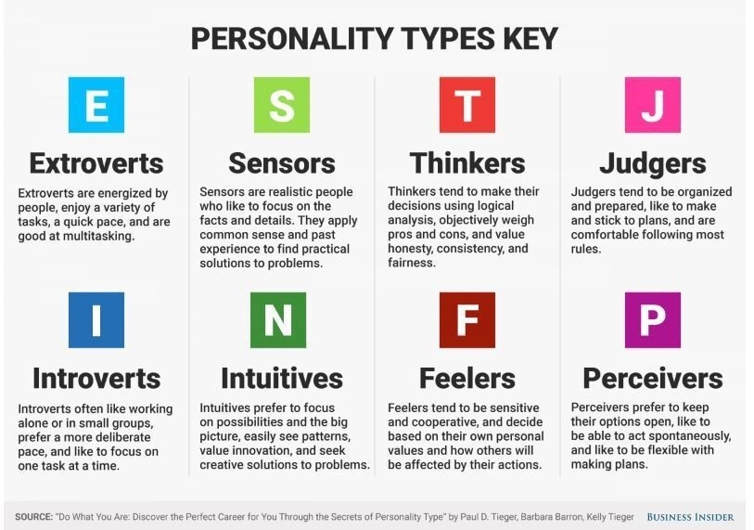
Personality types Labels
Notes:
16 Personality Types made up of combinations of 4 Personality Keys
There is significant overlap between Personality Types due to this.

Slide 4
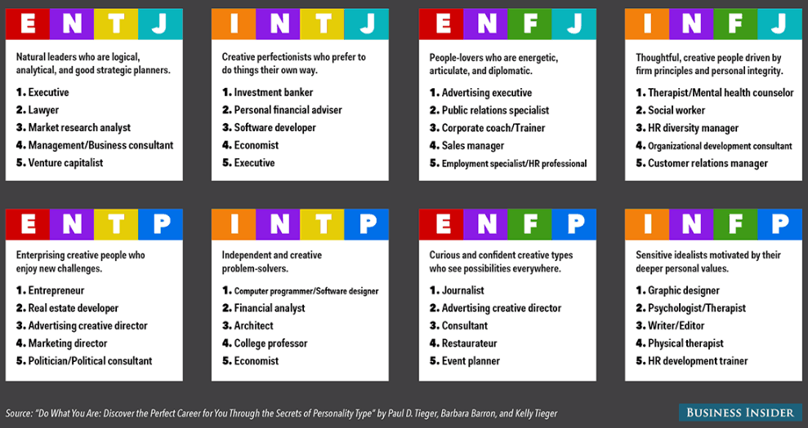
Personality types JOB TITLEs
Notes:
16 Personality Types made up of combinations of 4 Personality Keys
There is significant overlap between Personality Types due to this.

Slide 5
Methods and Models
Discovery Methods
Training Models
Naïve Bayes
KNN
Topic Modeling
Random Forest
K-Means
LDA
SVM
Deep Neural Network
Bonus: Prediction Application
Notes:
Pre-Processing
Stem
Lemmatize
Define and Remove Stop Words

Slide 6
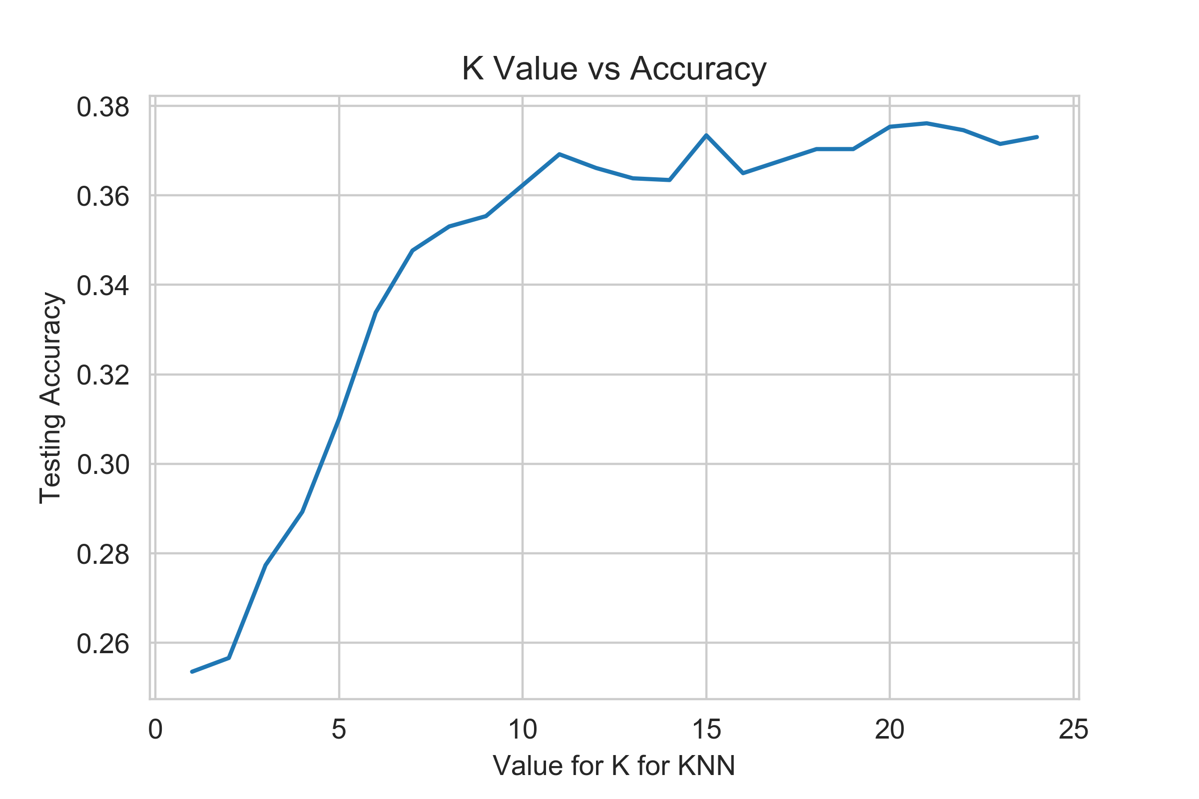
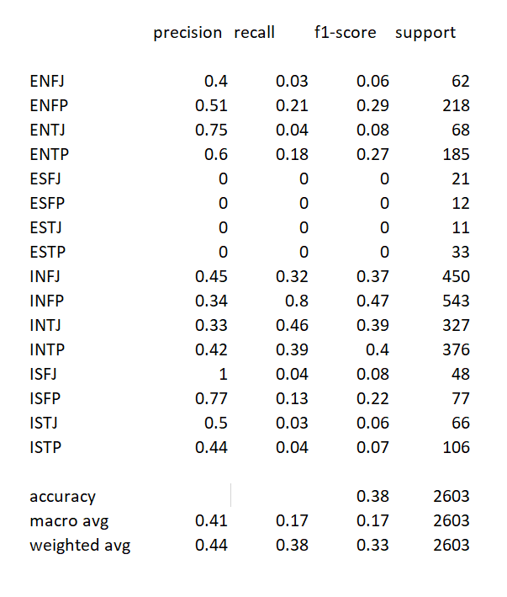
Discovery: K Nearest Neighbor
Results with k=21
Notes:
The best KNN could do is .38 accuracy with k=21.
ISFP was labeled with the most precision
ESFJ, ESFP, ESTJ and ESTP were not recognized at all

Slide 7
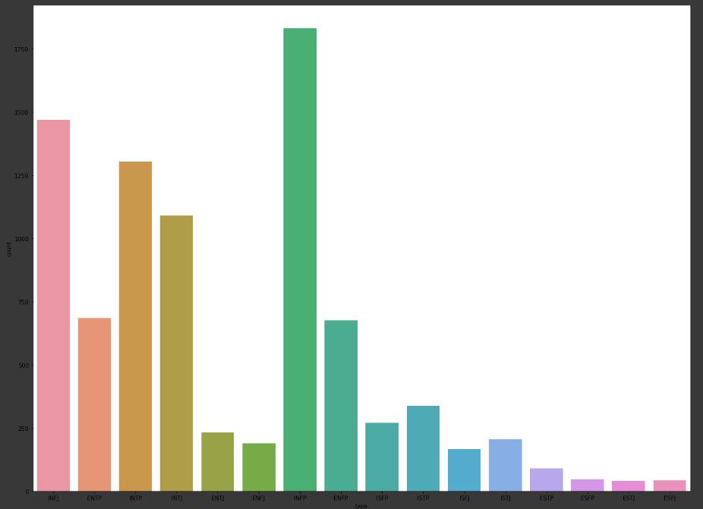
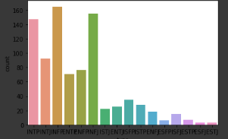
Training Methods: Label Breakdown
Complete Dataset
Test Labels
Notes:
Keeping same distribution.
15% test value set
Using all the labels, not sub-setting or combination/feature reduction.
Big green one is INFP,
INFJ….bonus

Slide 8
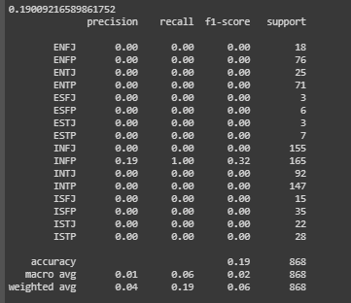
Majority Rule & basic analysis
Accuracy = 19.01%
Only guess INFP
Notes:
Majority rule is a 19.01% and is only INFP
Basic analysis, is a naïve bayes, with 0 stop words, no stemming, or lemitization etc. count vectorizer.
Why do this, to show the need for more effort. If this predicted already at 99.9% there would be such a small return on value, that you wouldn’t need our expertise.
Hence, we went all out, of

Slide 9
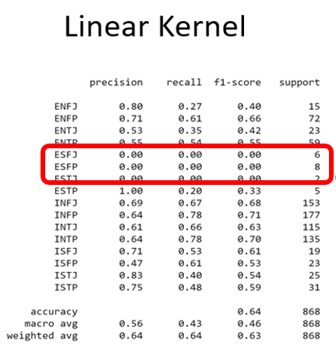
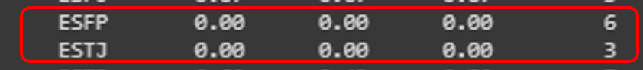
Results, form overall
Model | Boolean | CountVect | TFIDF
Naïve Bayes | 34% | 36% | 22%
SVM Linear | 51% | 59% | 64%
MLP | 67% | 69% | 74%
Notes:
More than these SVM were tested, Linear just did the best
Other methods like RandomForest Classifier was also looked at and will be discussed in the supplement discovery
Stop words and a count vectorizor, along with a porter stemmer.

Slide 10
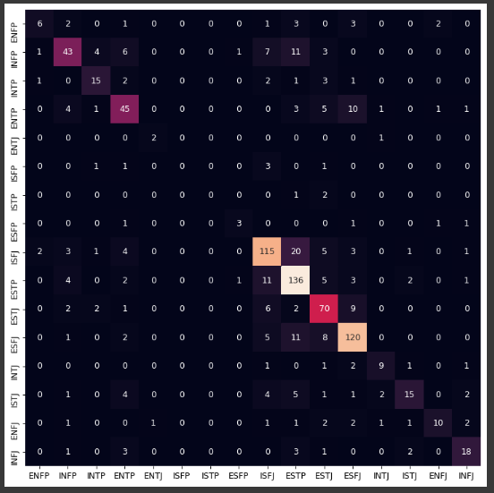
Deep Neural network
Accuracy = 70%
*Due to prediction model
Largest Incorrect Guesses:
ISFJ – ESFJ
INFJ - INSJ
Notes:
Sklearn MLP model preformed the best.
Applied stop-words
TF-IDF
Potter Stemmer
Values were 72.07 – 74.19 %
On various holdout
Largest incorrect guesses are when realtitvily 3 of the 4 same personalities.
Also it is assuming that topic or sentiment or other such factors didn’t come into play. Hence, I am not sure I would want to try and specify more in using this dataset.
However, results are for a hold out is for when not stemming . Coverned in next section

Slide 11
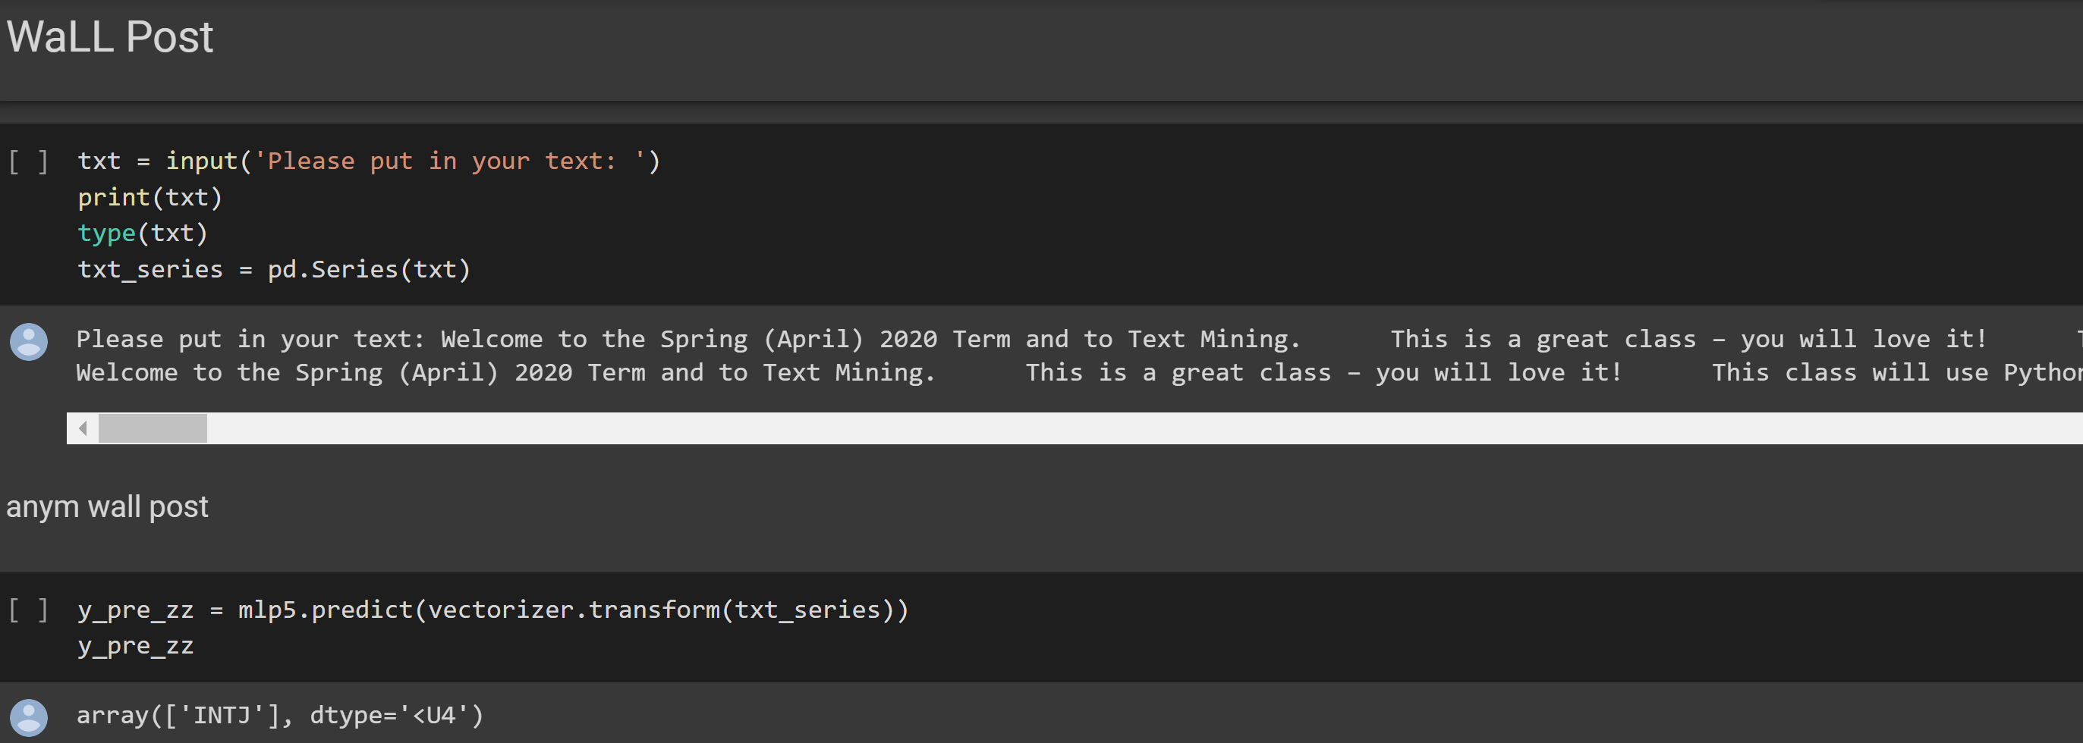

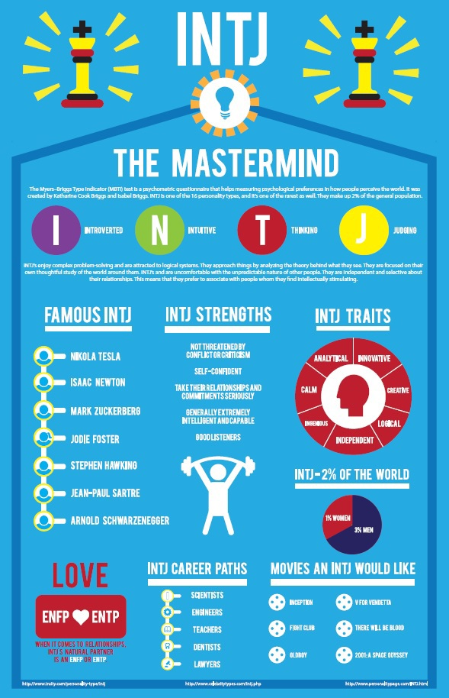
Random Professors Wall Postings
Demo:

Slide 12
Areas of Opportunity
The data came from self generated comments with no topic control/off the cuff
No context to the topic or discussion curation
Greater emphasis of word filtering

Slide 13
Appendix: Additional Information

Slide 14
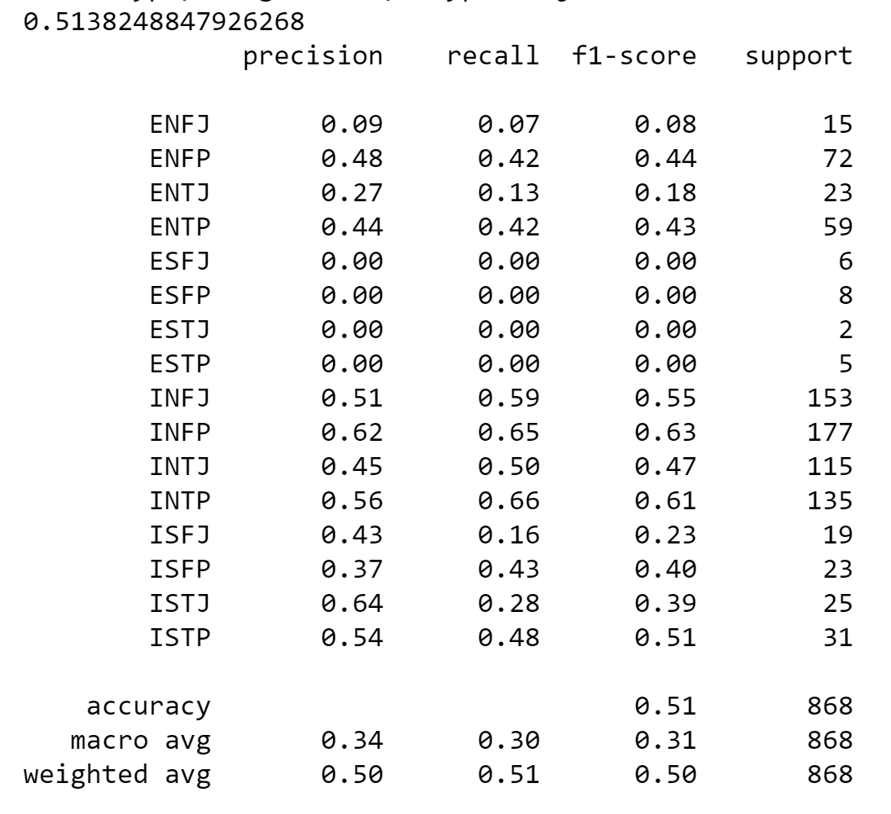

SVM’s Using Boolean Vectorizer
The Linear Kernel had the best result with 51.4% Accuracy

Slide 15
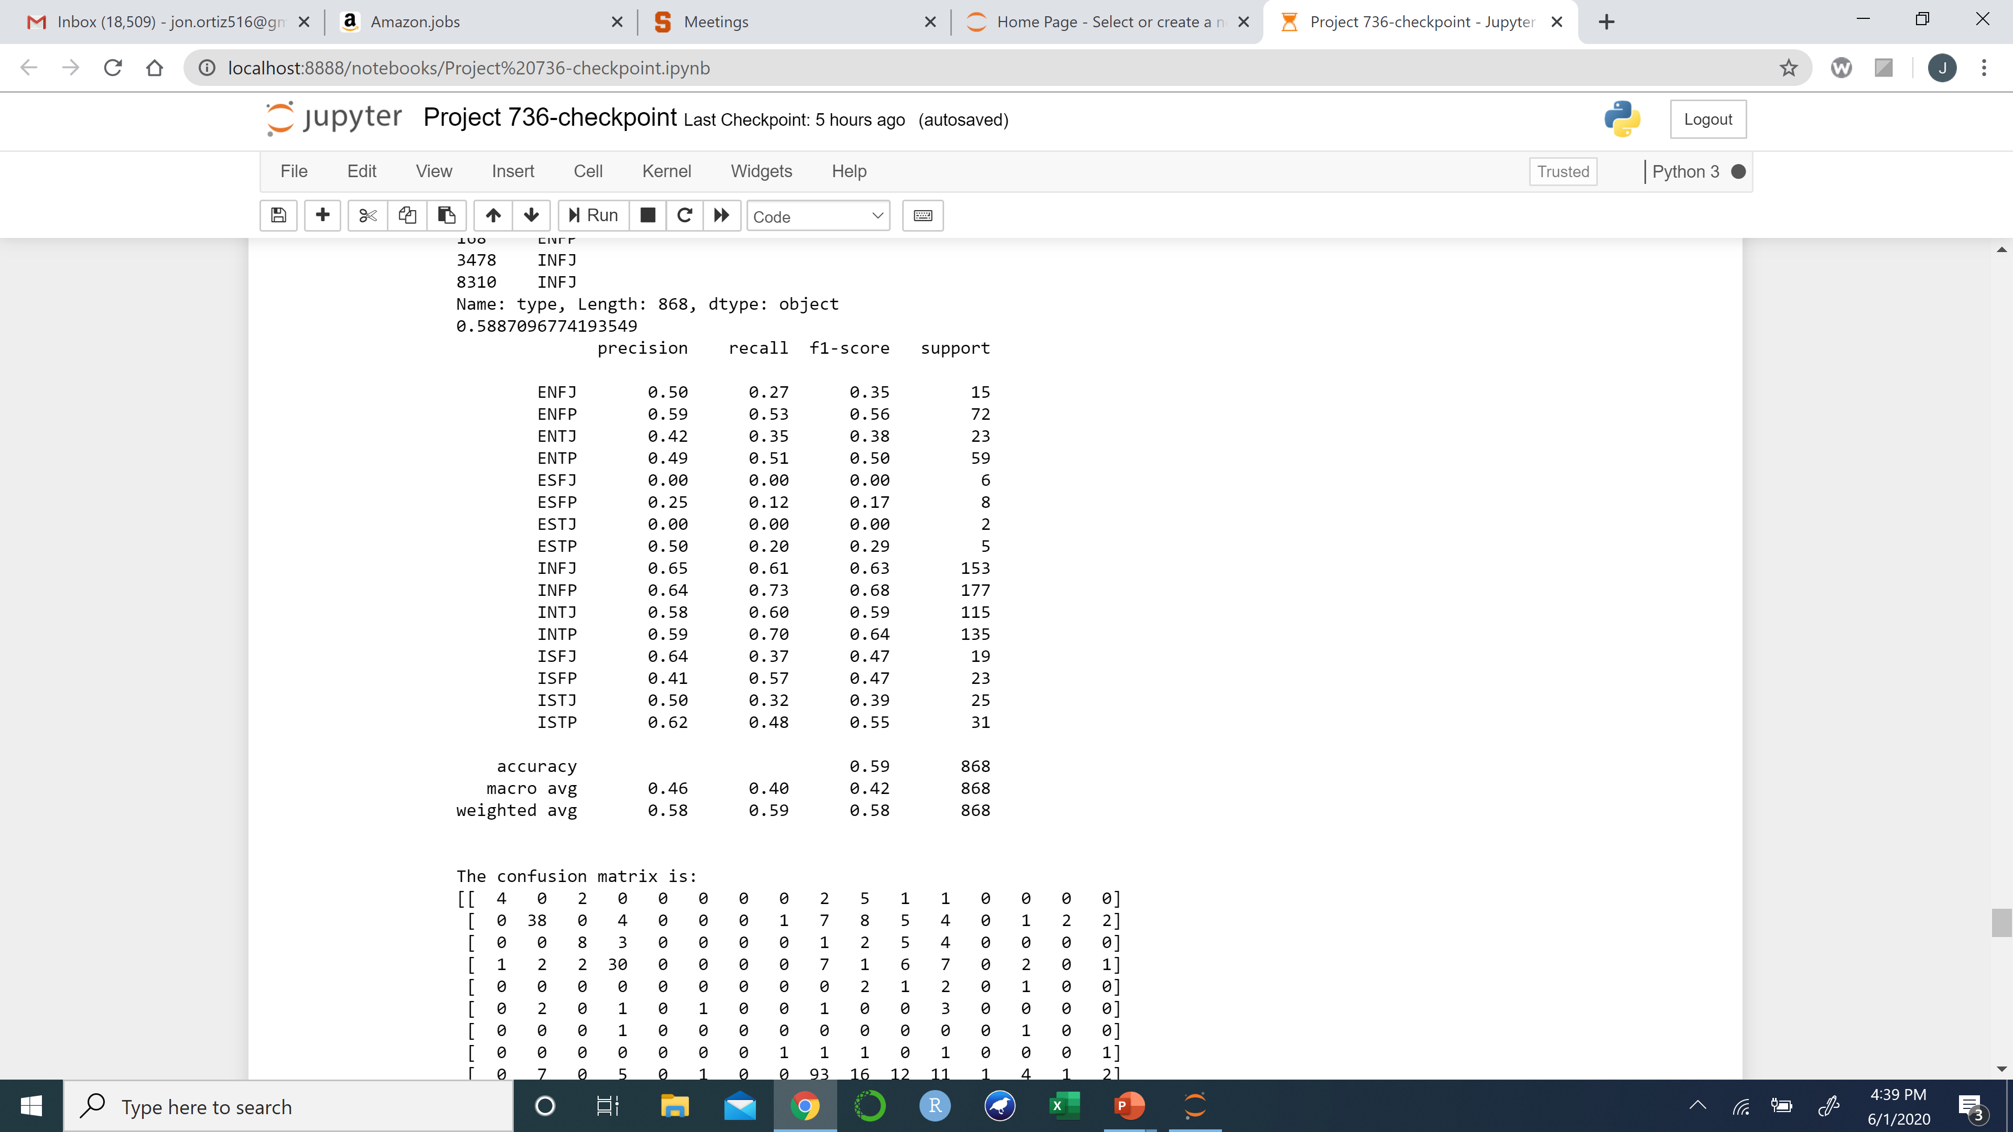
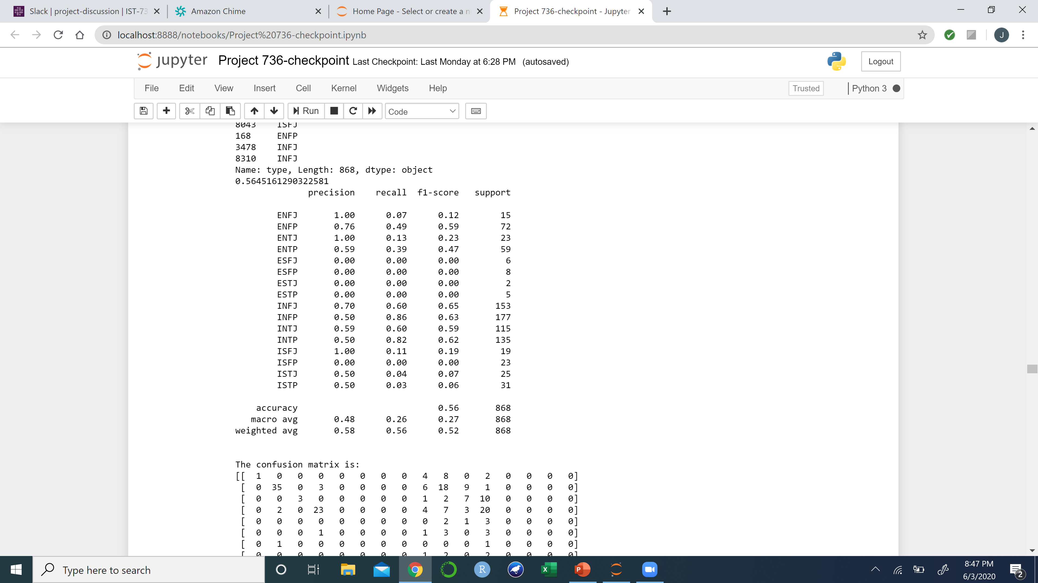


SVM’s Using Count Vectorizer
Linear Kernel
Polynomial Kernel
The Linear Kernel had the best accuracy with 58.87%, the Polynomial Kernel came in close with a 56.45% accuracy.

Slide 16
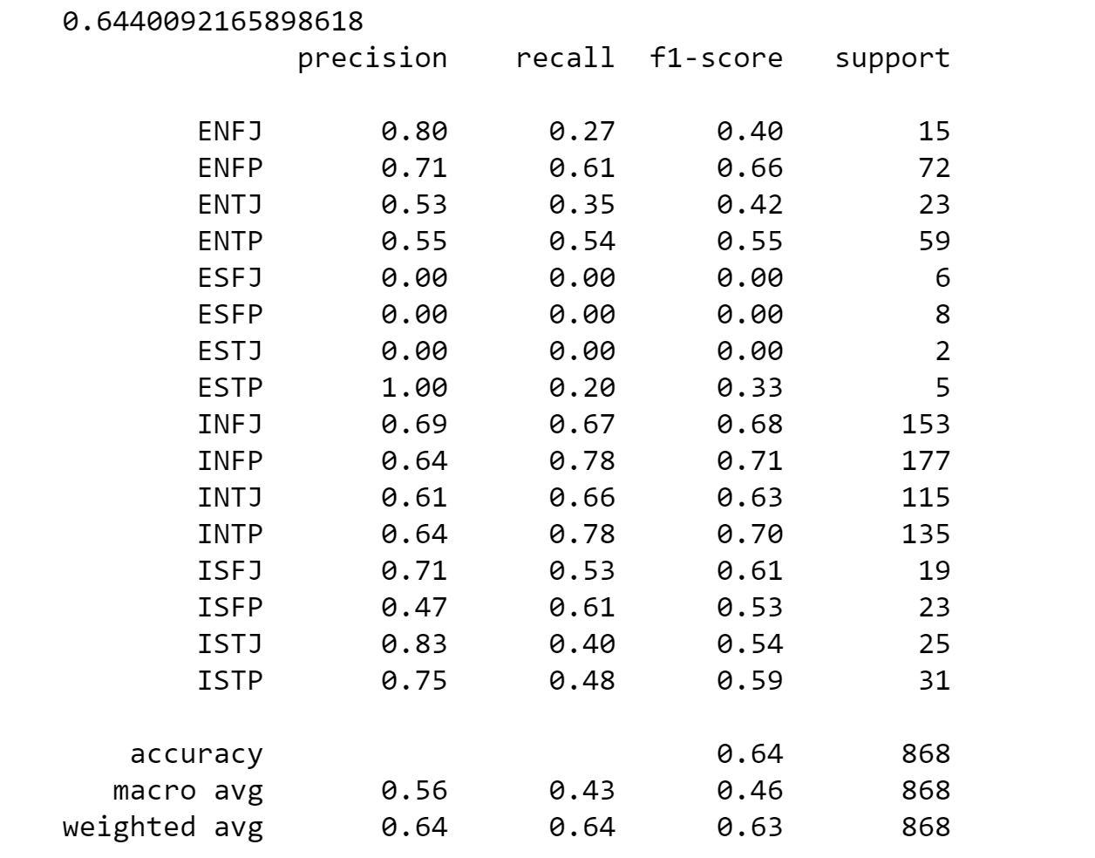

SVM’s Using TFID Vectorizer
Linear Kernel
The linear kernel performed the best on all three sets for vectorized data. The most accurate of the SVM models is the TFID vectorized data with the linear kernel. The accuracy is 64.4%

Slide 17

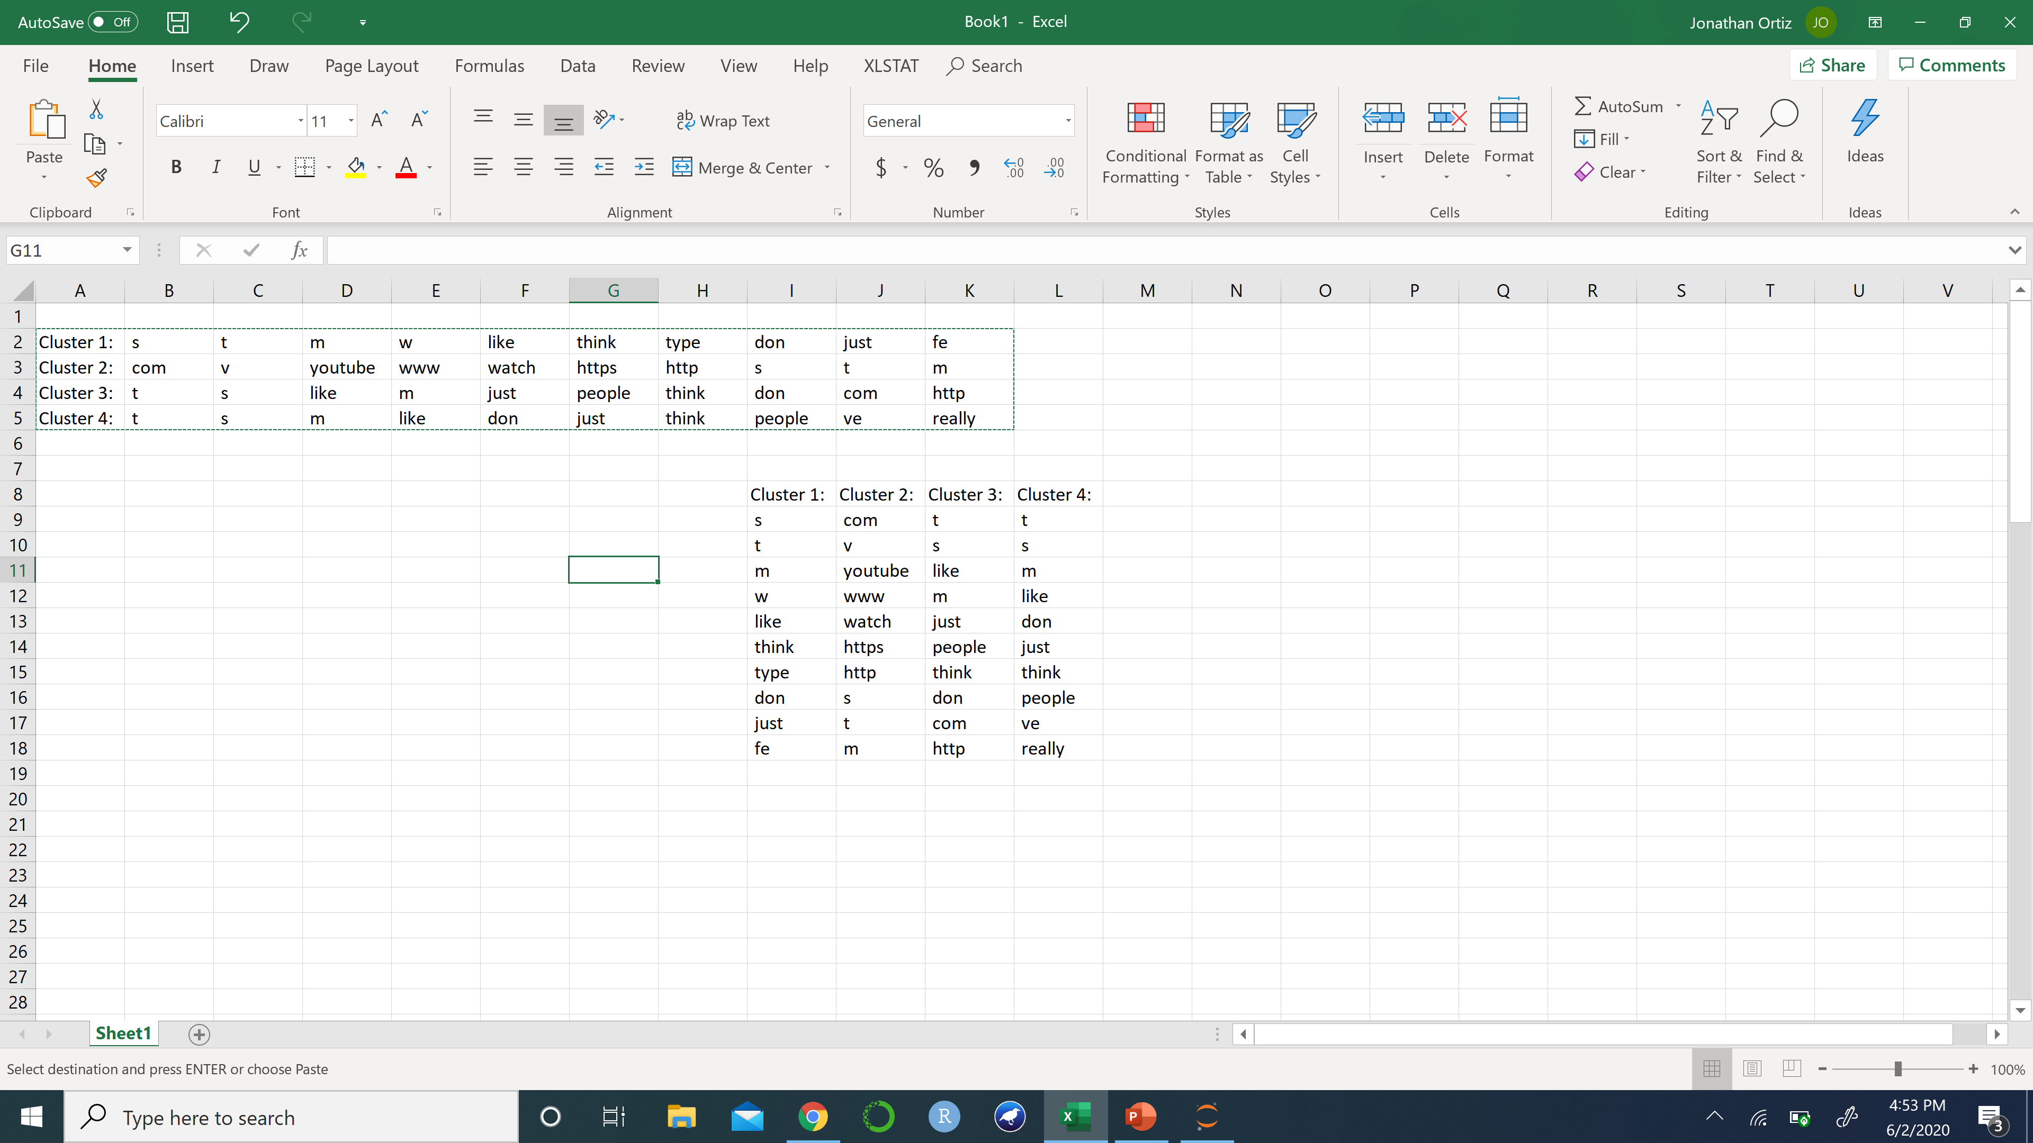
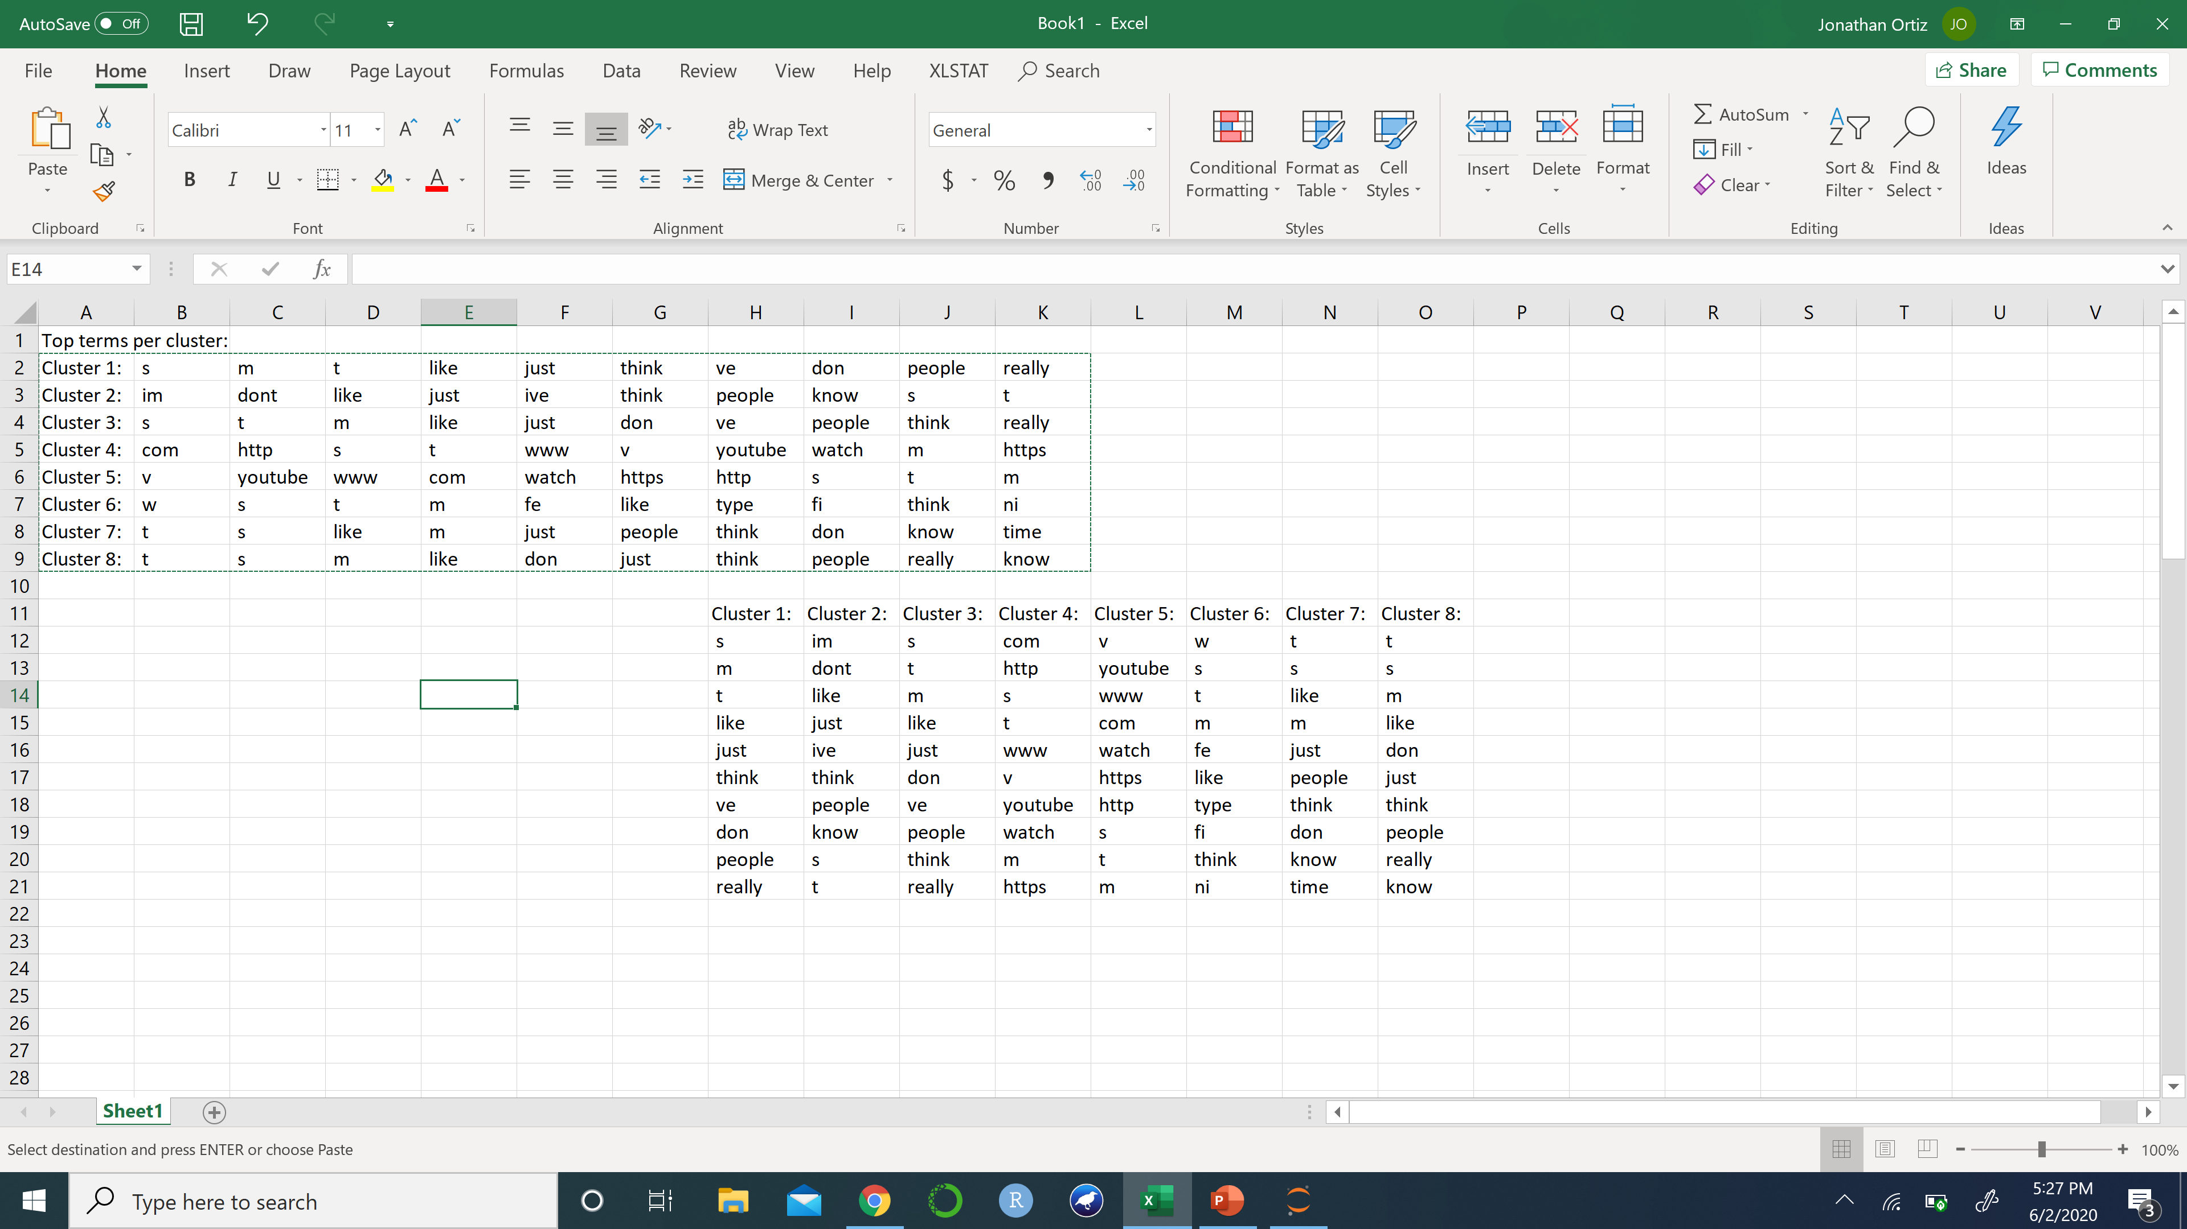
K-Means Clustering TFID Vectorizer
2 clusters
4 clusters
8 clusters
Trying multiple clusters really shows no real topics. This could be because the training data set is comments, which can all be regarding the same topics. A different data set of original posts could give us different results.

Slide 18
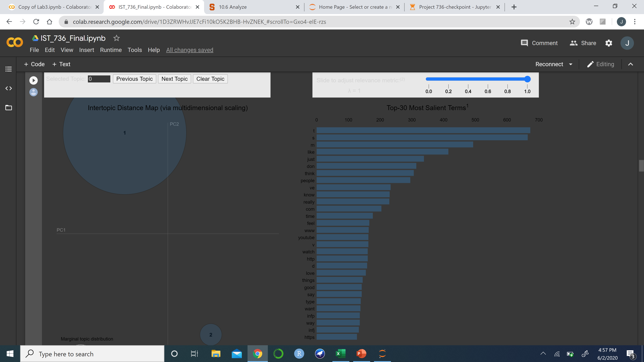
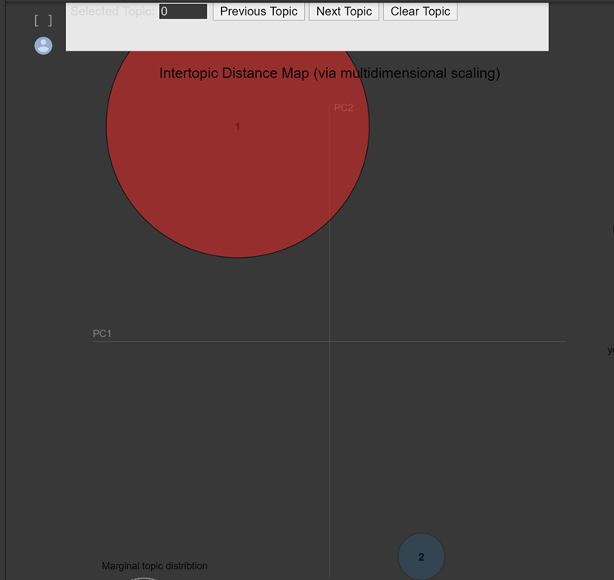
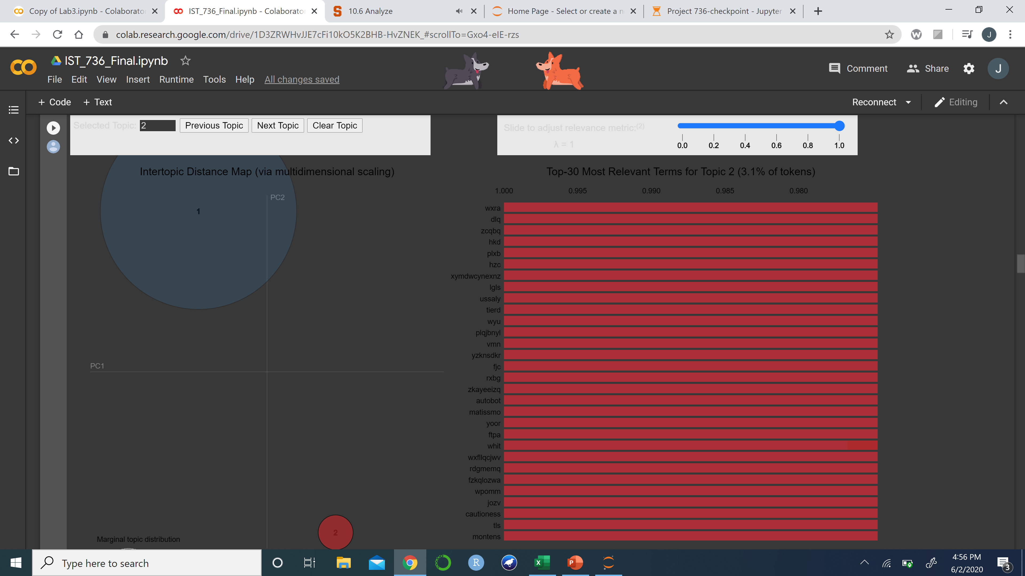
LDA Topic Model
Topic 1
Topic 2
Topic 1 seems to contain some common use English words, while topic 2 is gibberish.

Slide 19
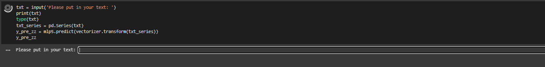
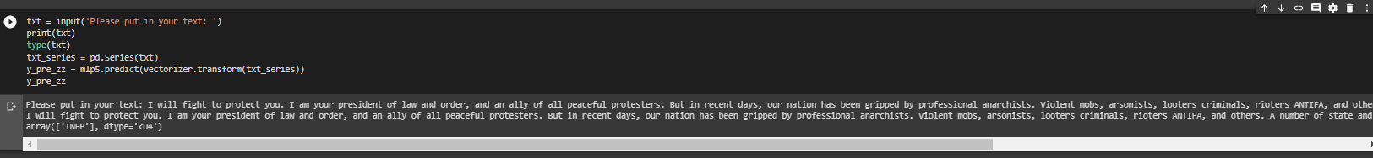
Demo: Prediction Model
Notes:
Prediction model, ran into an issue, when trying to do a stemmer inside a pipeline. Was trying to get it to be a function where you feed it a file or text and it just runs it through, I could always get it when a stemmer is not applied to the pipeline
Guessing something to do with the local defined vs. globally defined function more time, would have liked to smooth it out, but interesting nune the lesss
But that is why 70 vs. mid-70 for accuracy
So we fed it some precedential speaches, tweets, etc, to see what I predicted.
Weakness, it won’t predict, and most models won’t predict these two values. Guessing too small footprint in dataset.

Slide 20
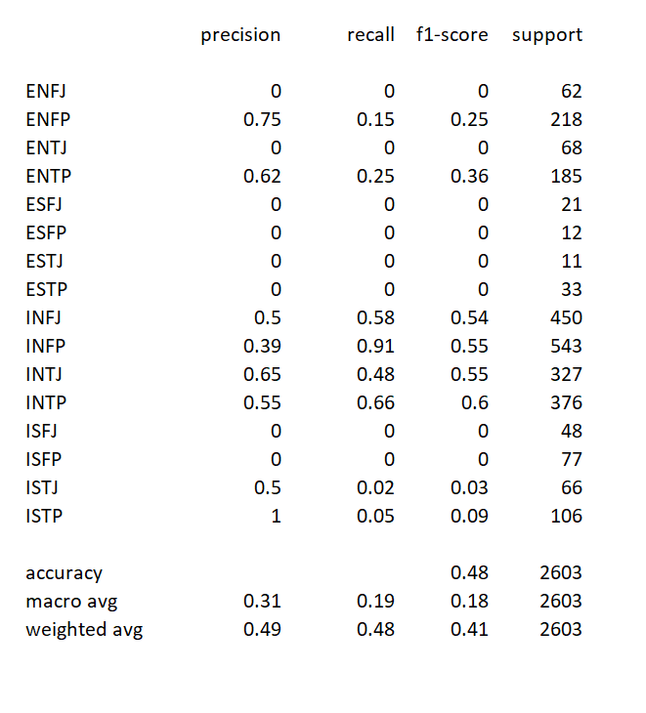
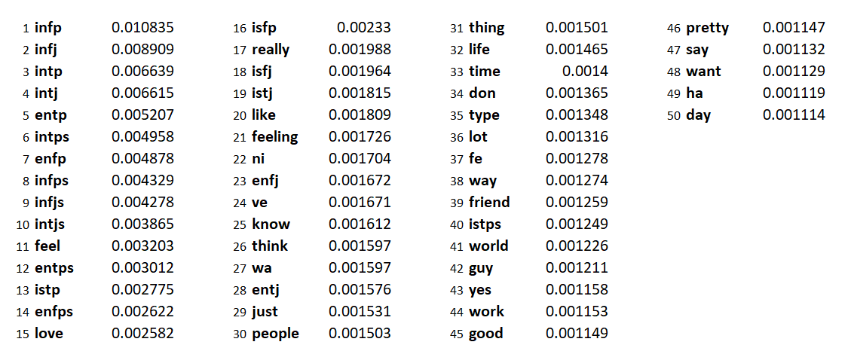
Random Forest
Top 50 Features

Slide 21
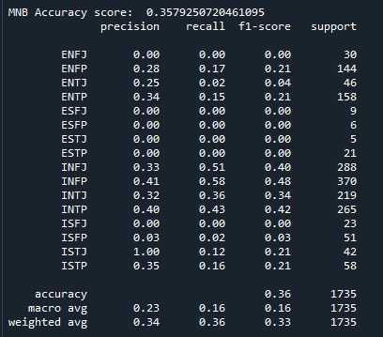
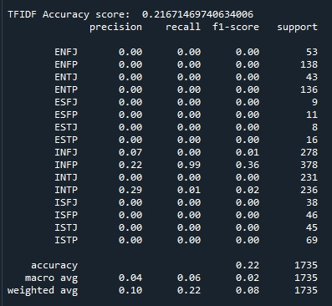
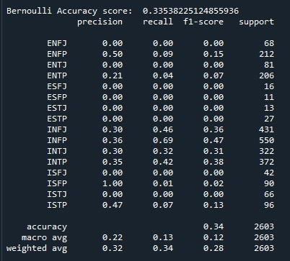
naïve BAYES
Count Vectorizer
TFIDF Vectorizer
Bernoulli Vectorizer

